Slide 1
Industrial Instrumentation

Slide 2
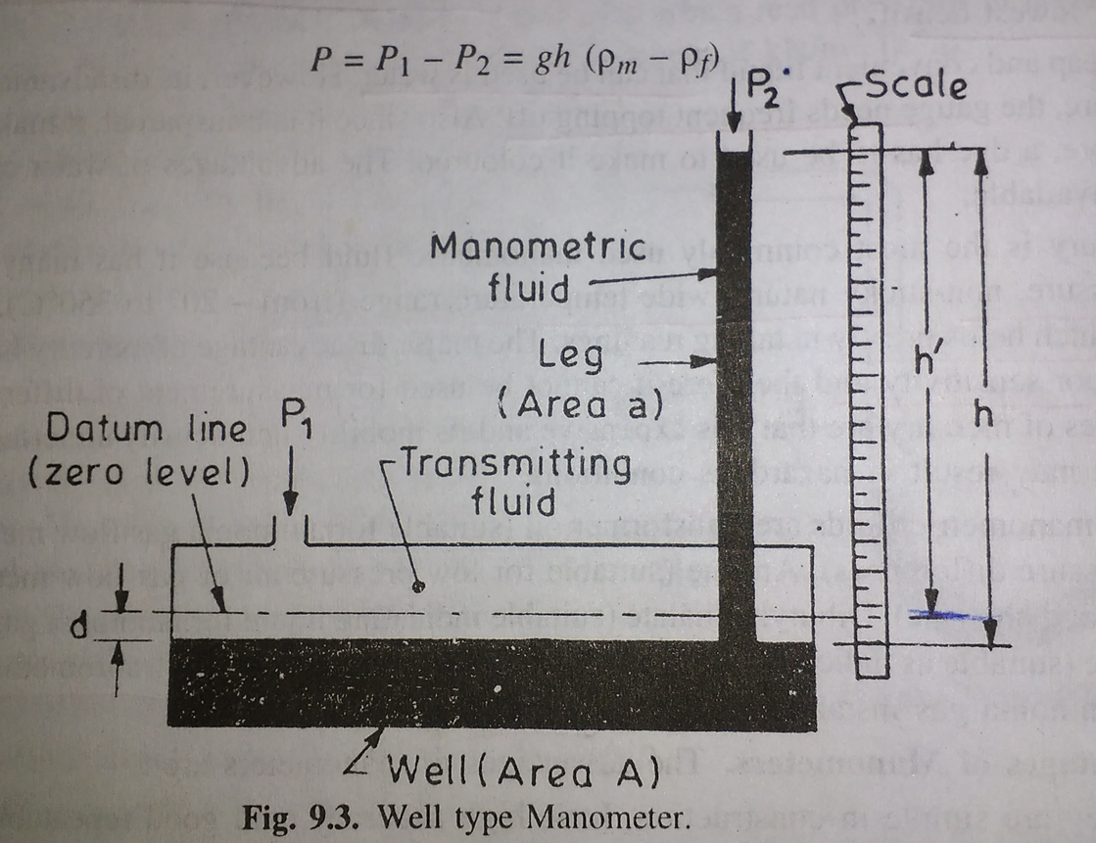
Well type manometer

Slide 3
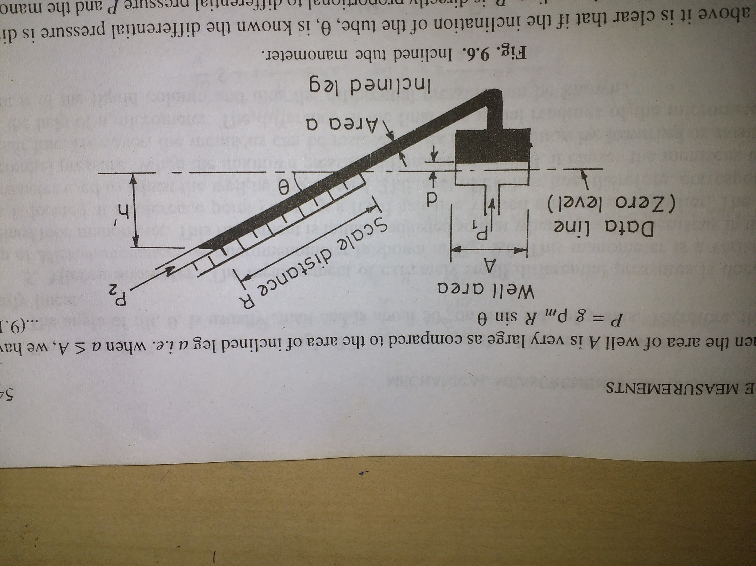
Inclined tube manometer

Slide 4
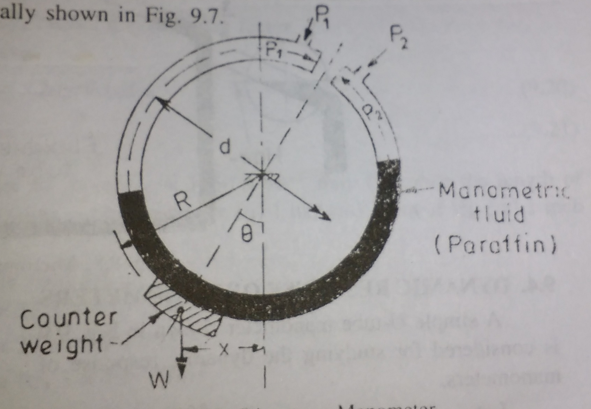
Ring Balance Manometer

Slide 5
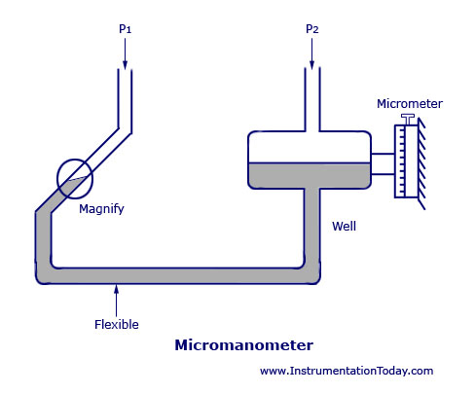

Slide 6
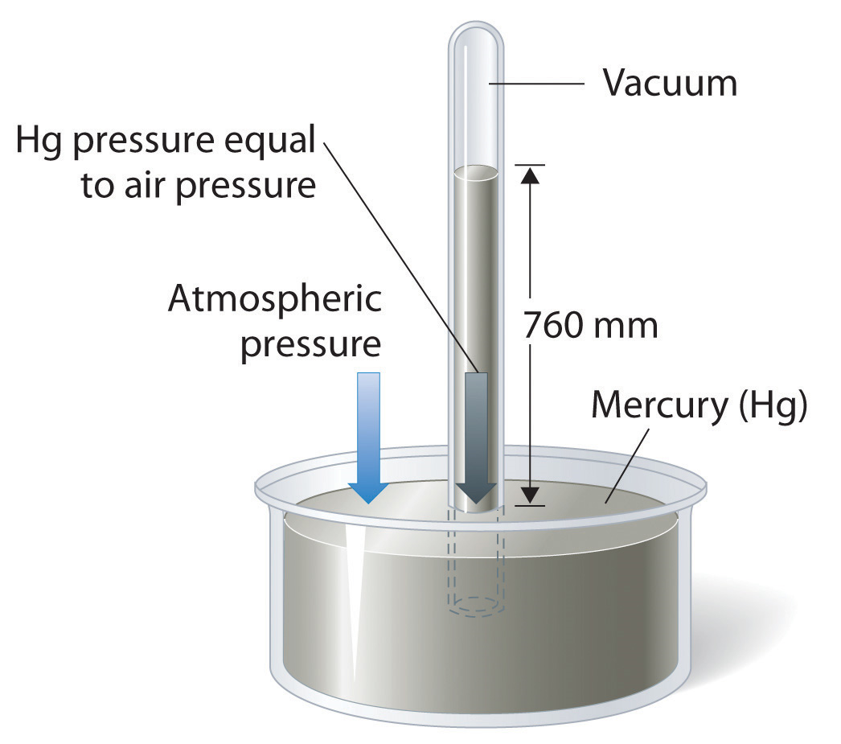
Barometer

Slide 7
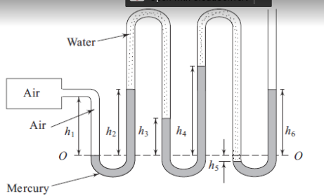
Problem.

Slide 8
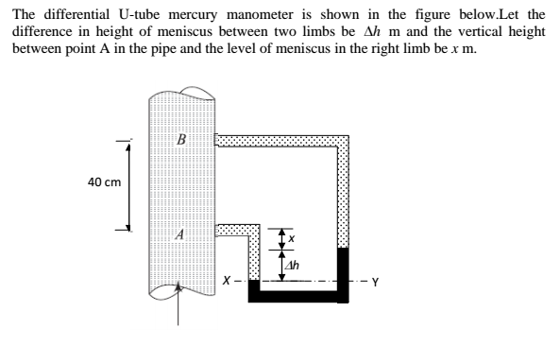

Slide 9
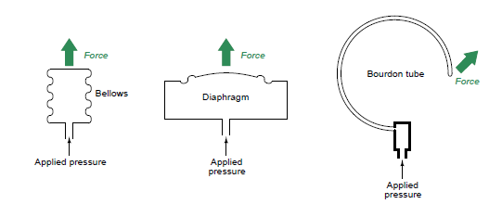
Elastic pressure elements
The natural elastic properties of the element will produce a motion proportional to the applied pressure.

Slide 10
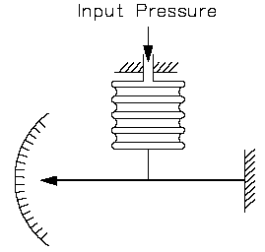
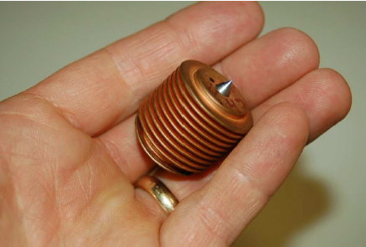
Bellows
Increasing pressure inside a bellows unit causes it to elongate
Materials of Construction: Brass, stainless steel, beryllium copper, Monel, bronze, copper, Inconel, Ni-Span
Bellows-type sensing elements are for low to intermediate pressures

Slide 11
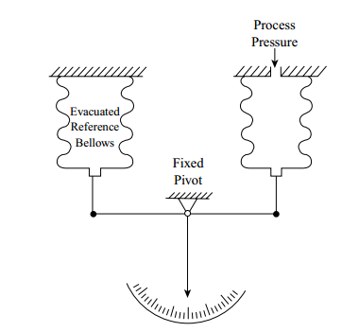
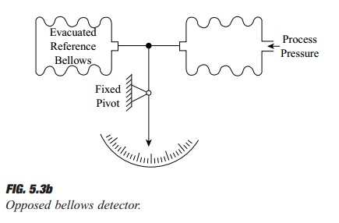
Absolute pressure measurement

Slide 12
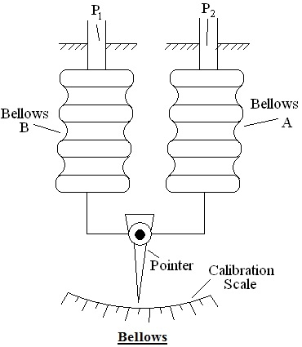
Differential pressure measurement using bellows

Slide 13
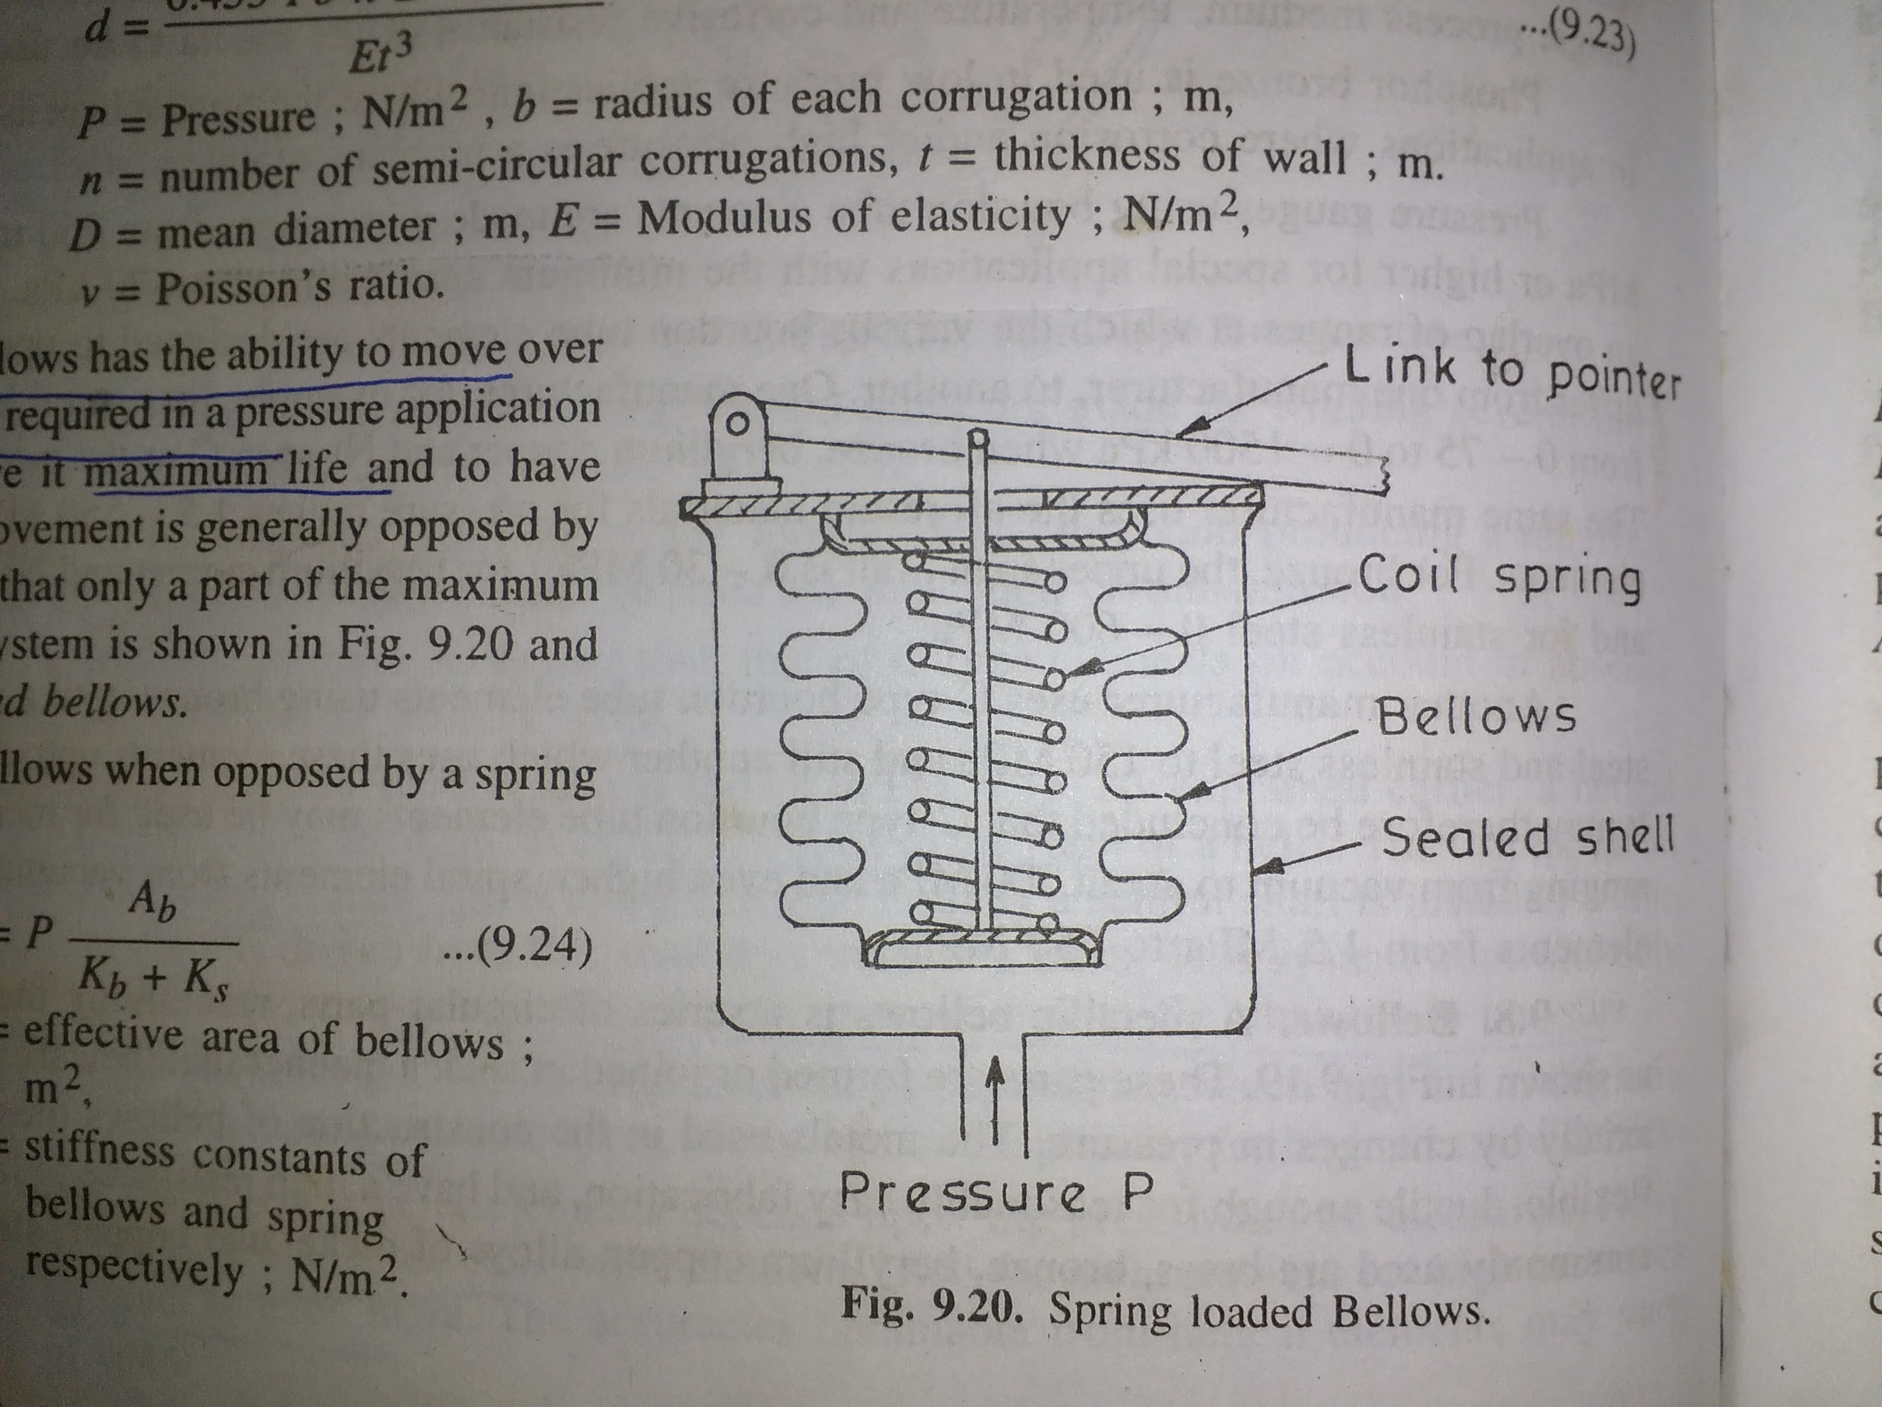
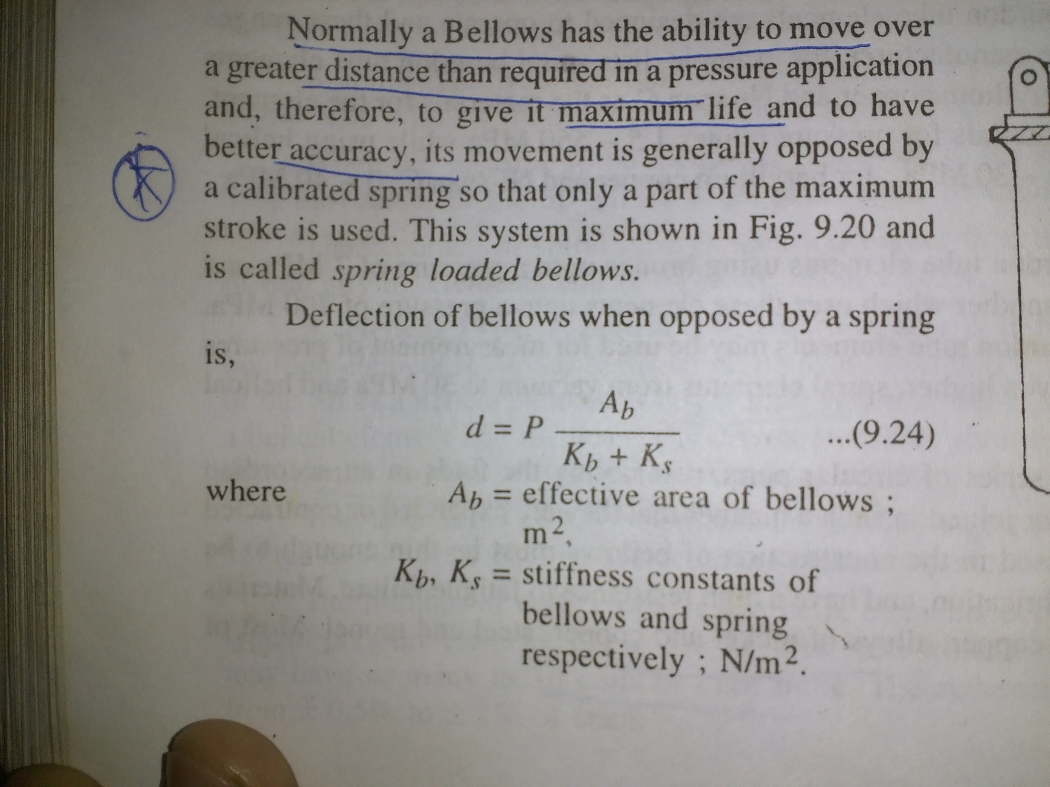
SPRING LOADED BELLOWS

Slide 14
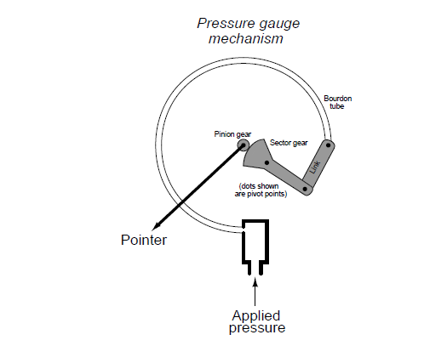
C-type Bourdon tube
Most pressure gauges use a bourdon tube as their pressure-sensing element. Most pressure transmitters use a diaphragm as their pressure-sensing element
Sensing elements for the measurements of medium to high pressures
Materials of Construction: Phosphor bronze, alloy steel, 316 and 403 stainless steel, beryllium copper, Monel,
Ni-Span C
Under the influence of internal pressure, a bourdon tube “tries” to straighten out.
Minimum span 15 PSI (100 kPa); maximum span 100,000 PSI (690 MPa)

Slide 15
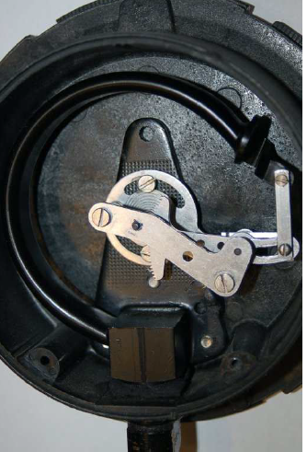
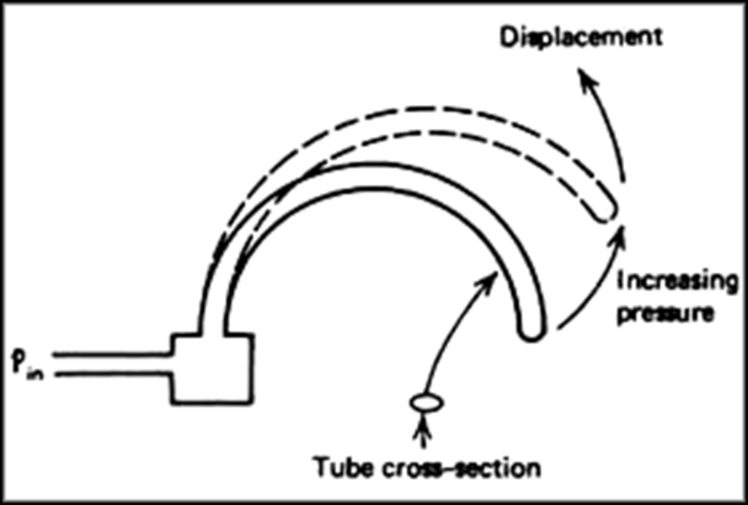

Slide 16
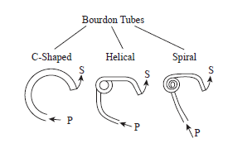

Slide 17
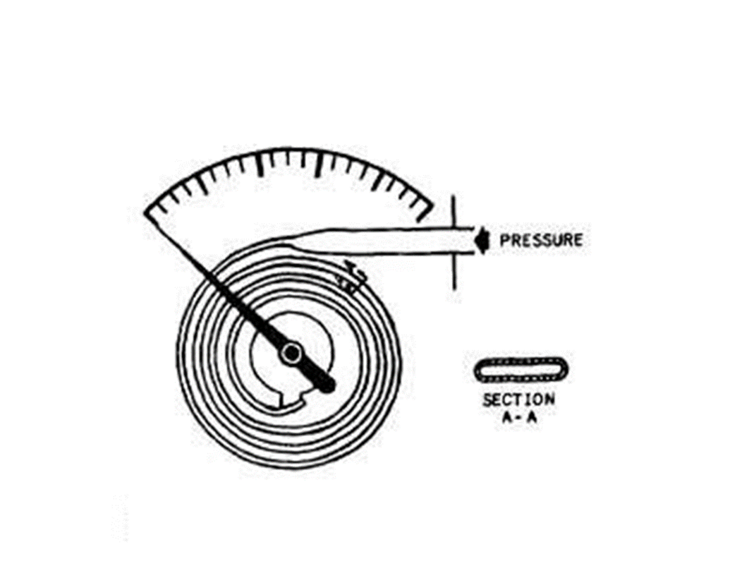
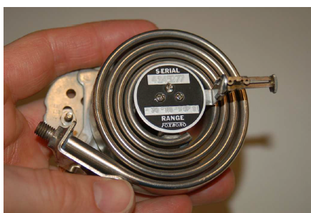
Spiral type bourdon tube

Slide 18
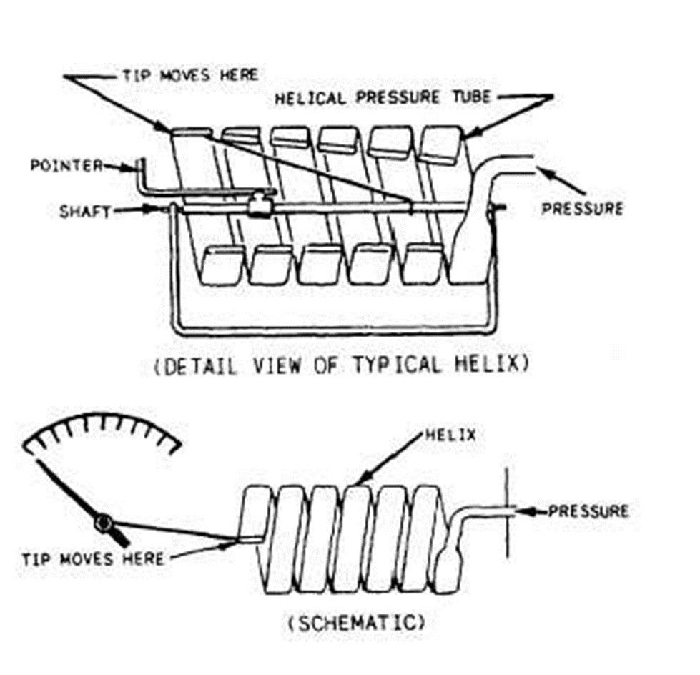
Helical type

Slide 19
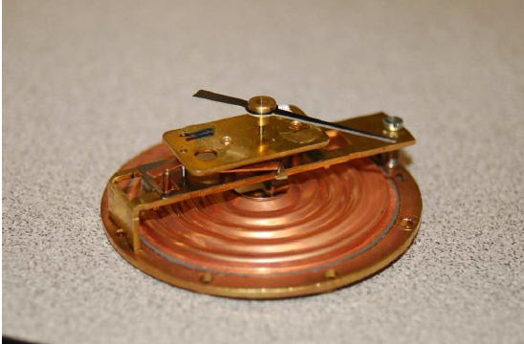
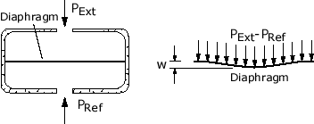
Diaphragm or capsule
Materials of Construction: Buna-N, nylon, Inconel, Ni-Span C, phosphor bronze, 316 stainless steel, beryllium
copper, Monel, brass, titanium, tantalum, Hastelloy, nickel,
Range: Absolute pressure ranges from 0–5 mmHg to 0–50 PSIA (0–0.7 to 0–350 kPa); gauge pressure ranges from 0–0.5 in. H2O to 0–200 PSIG (0–0.12 kPa to 0–1.4 MPa).

Slide 20
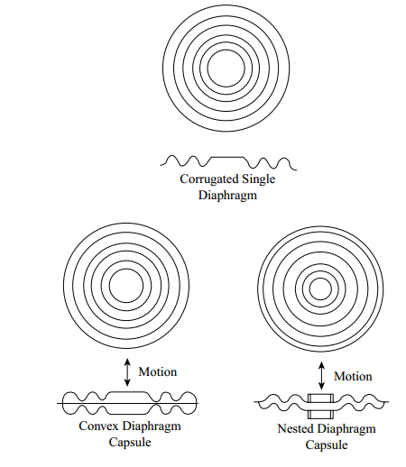
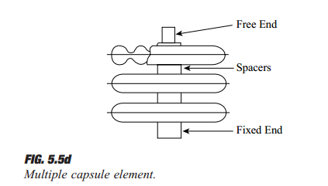

Slide 21
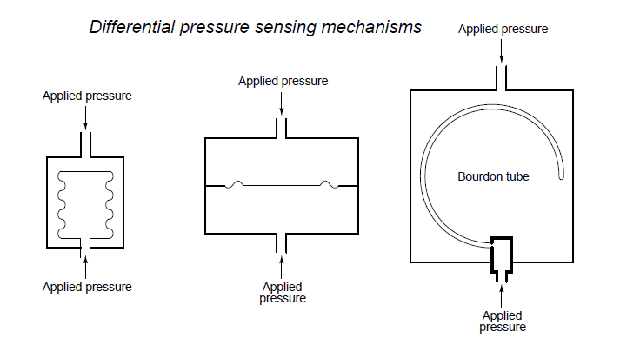
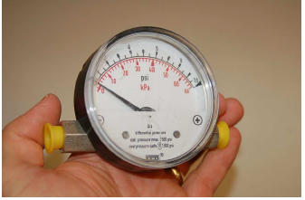

Slide 22
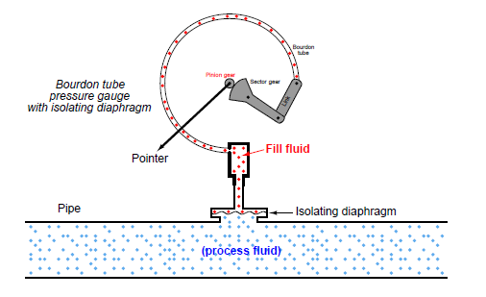
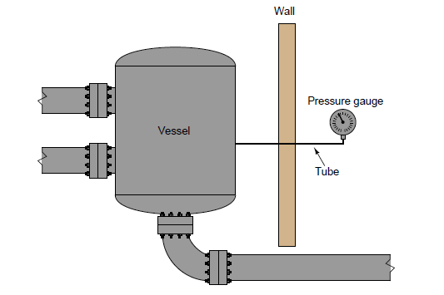
Applications of pressure gauges

Slide 23
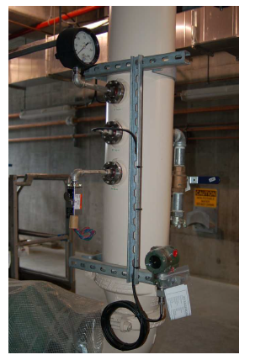

Slide 24
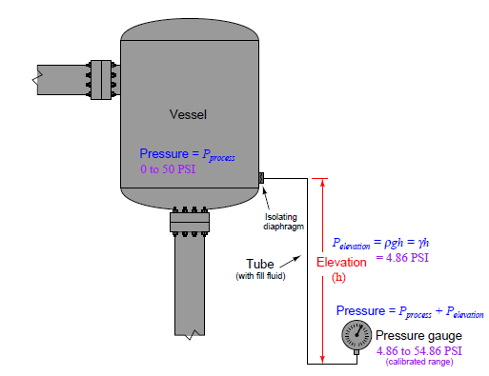

Slide 25
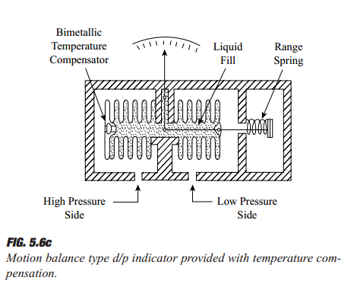
Differential pressure measurement

Slide 26
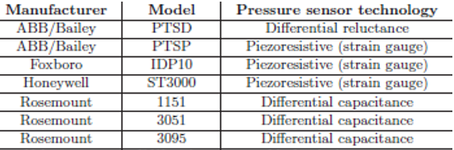
Electrical type pressure measurement devices
conversion of fluid pressure into an electrical signal

Slide 27
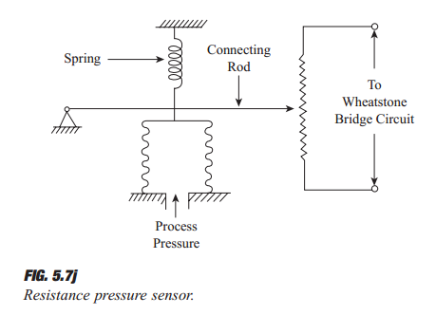
Potentiometric transducer

Slide 28
The potentiometric pressure sensor provides a simple method for obtaining an electronic output from a mechanical pressure gauge. The device consists of a precision potentiometer, whose wiper arm is mechanically linked to a Bourdon or bellows element.
Potentiometer Pressure Transducers Working PrincipleAn increase in pressure makes the bourdon tube straighten out partially. This motion causes the linkage to move the wiper across the winding on potentiometer as the wiper moves; it increases the resistance between terminals A and B which is equal to the pressure sensed by the bourdon tube.

Slide 29
Potentiometric Pressure Transducers Advantages
Provide strong output so no need of additional amplifierThey have high range and have high ruggednessThey have simple instrumentation, have high electrical efficiency and are inexpensive
Disadvantages
Potentiometer pressure transducers have finite resolution, limited life and large sizeThey have poor frequency to response and have tendency to develop noise

Slide 30
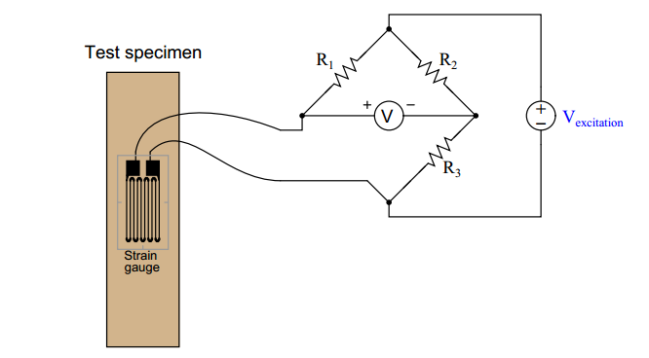
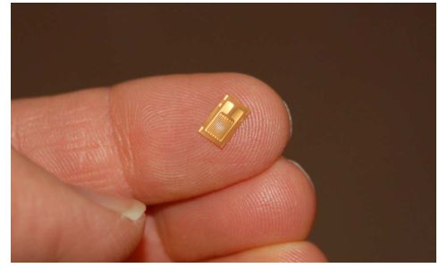
Piezoresistive (strain gauge )sensors

Slide 31
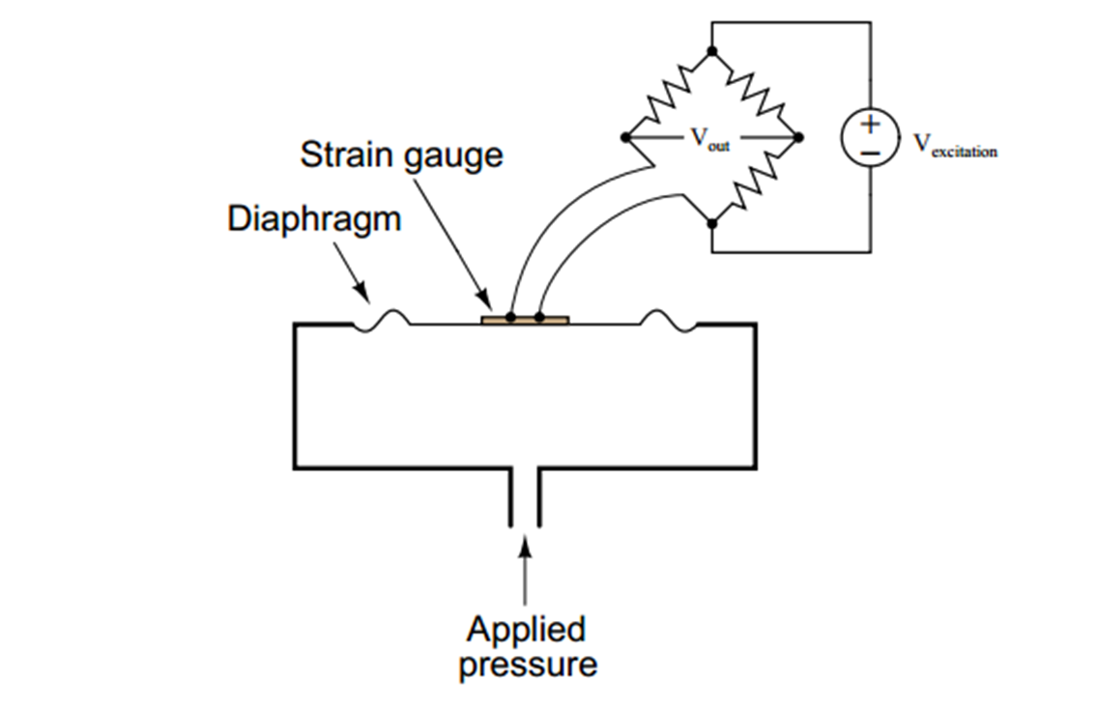
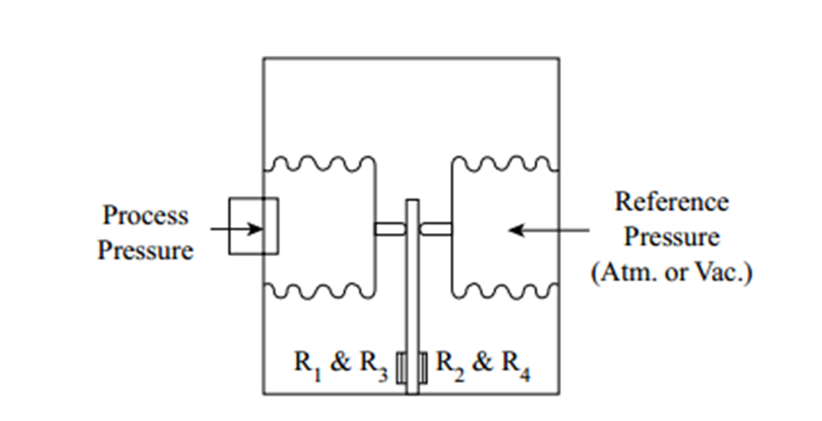

Slide 32
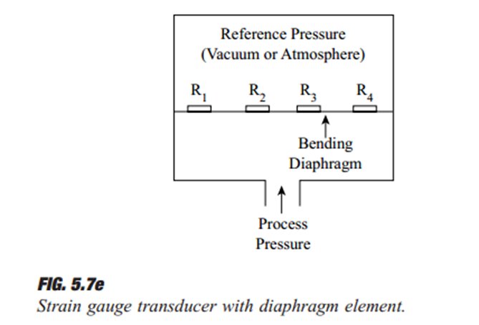
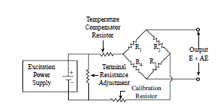
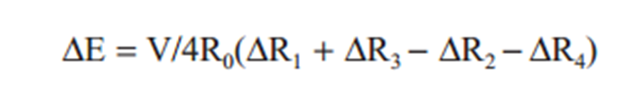

Slide 33
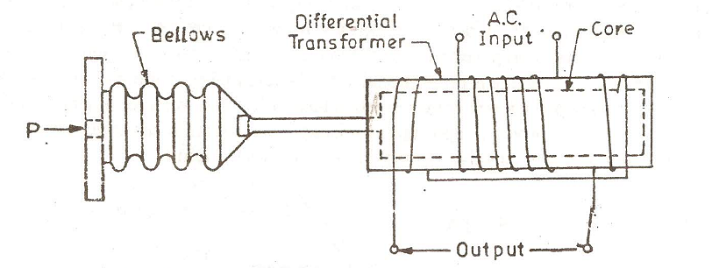
LVDT for pressure measurements

Slide 34
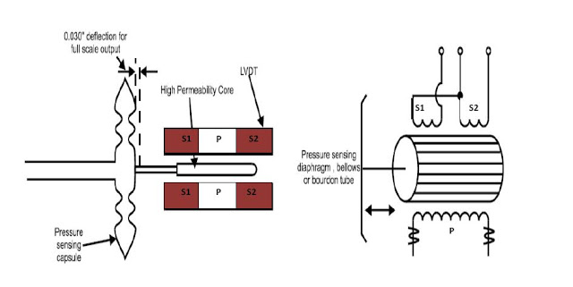
LVDT for pressure measurements

Slide 35
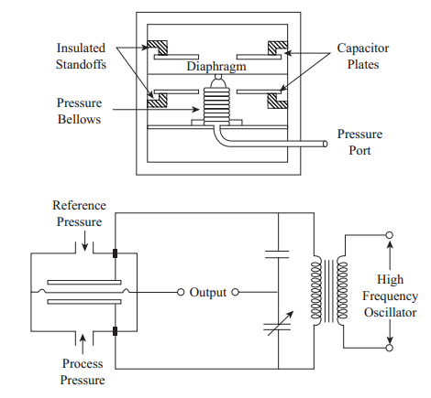
Capacitive pressure transducer

